Slide 1
Restricting Users for Editing by User Group or Role
Yoel Kortick May 2024

Slide 2
Agenda
Introduction
Example 1 - Restrict by User Group
Example 2 - Restrict by User Role

Slide 3
Introduction

Slide 4
Introduction
In Alma the following user roles in Alma can make changes to Alma user accounts:
  General System Administrator
  User Administrator
  User Manager
  Circulation Desk Manager
  Circulation Desk Operator
  Circulation Desk Operator - Limited
  Repository Manager

Slide 5
Introduction
However, even though these user roles can make changes to Alma user accounts, it is possible to prevent these user roles from making changes to specific user accounts (for example, editing contact info).
This is a two-step process:
Define accounts as 'restricted for editing' in the Users Restricted for Editing table (Configuration Menu > User Management > Roles and Registration > Users Restricted for Editing).
  If a user account has any of the roles defined in this table or is assigned any of the user groups listed in this table, then this account is considered 'restricted for editing’.
For the user roles that can make changes to Alma user records (the above-listed roles), the "Can't edit restricted users" parameter can be activated.
  This prevents these users from making any changes to the ‘restricted for editing’ accounts.

Slide 6
Introduction
See also Restricting Users for Editing at https://knowledge.exlibrisgroup.com/Alma/Product_Documentation/010Alma_Online_Help_(English)/050Administration/040Configuring_User_Management/020Roles_and_Registration_Configuration#Restricting_Users_for_Editing

Slide 7
Example 1 - Restrict by User Group

Slide 8
Example 1 - Restrict by User Group
In this example we will make the User Group “Faculty” be a “Restricted User Group”.
This means that any staff user who
  Has a role which can edit users
  The role(s) which can edit users does not have the checkbox “Can’t edit restricted users” checked
Will be able to edit all users including those with User Group “Faculty”.
If, however, the role(s) which can edit users does have the checkbox “Can’t edit restricted users” checked then the staff user will be able to edit all users except for those with User Group Faculty.
We will now see this live.

Slide 9
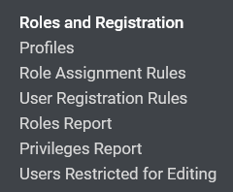
Example 1 - Restrict by User Group
We will access the configuration at ”Configuration > User Management > Roles and Registration > Users Restricted for Editing”.

Slide 10
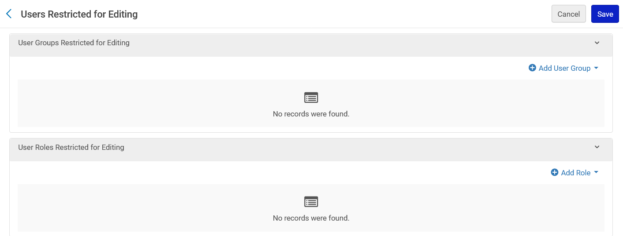
Example 1 - Restrict by User Group
In the section “User Groups Restricted for Editing” we will click “Add User Group”

Slide 11
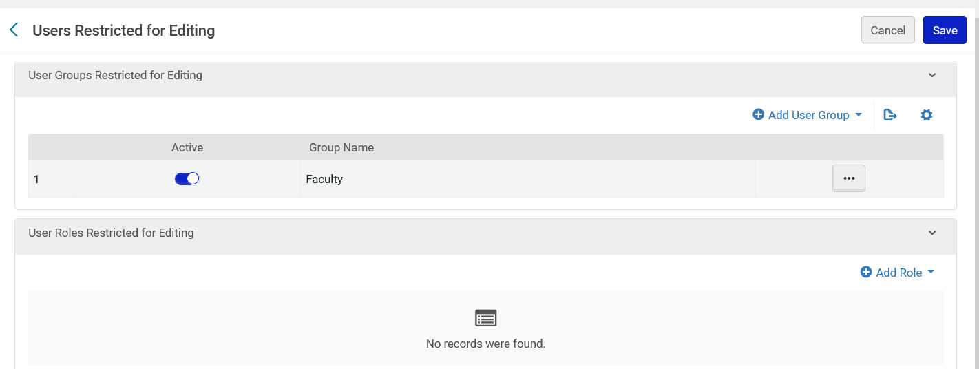
Example 1 - Restrict by User Group
We have added User Group “Faculty”

Slide 12
Example 1 - Restrict by User Group
User James Meydansky has User Group “Faculty”

Slide 13
Example 1 - Restrict by User Group
Staff User Jacqueline Fernandez has roles
  “Circulation Desk Manager”
  “Circulation Desk Operator”
In both cases “Can’t edit restricted users” is not checked.
Jacqueline Fernandez can therefore edit all users.

Slide 14
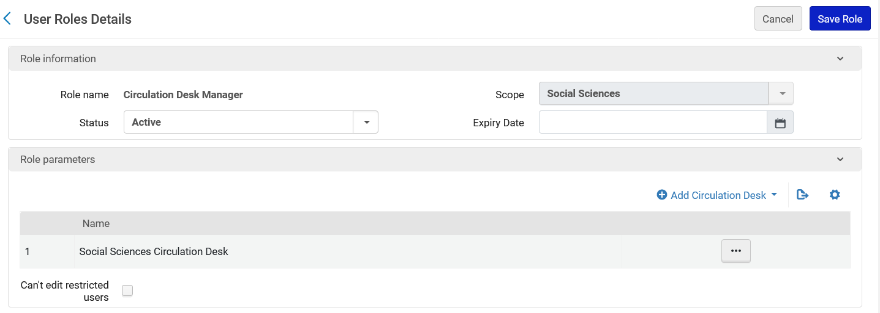
Example 1 - Restrict by User Group
Role “Circulation Desk Manager” and “Can’t edit restricted users” is not checked.
Not checked

Slide 15
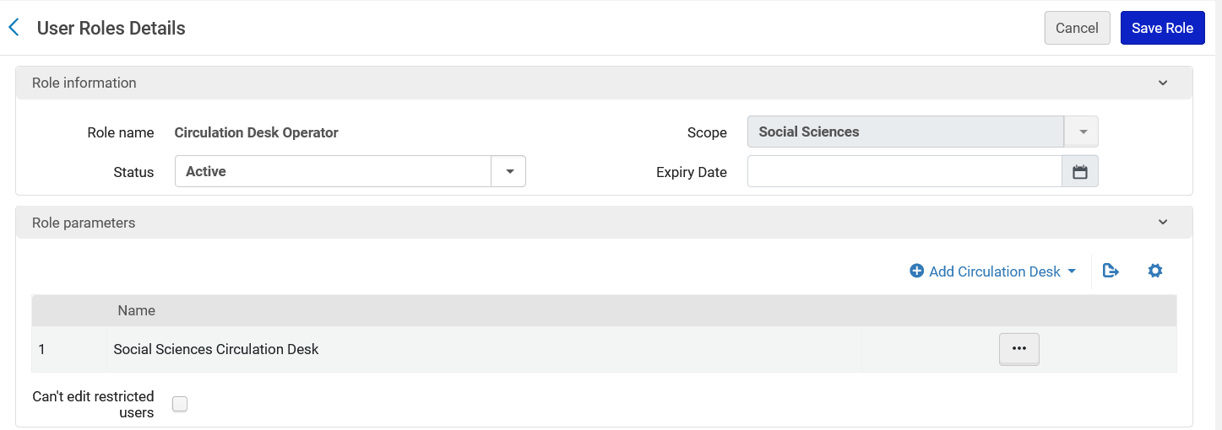
Example 1 - Restrict by User Group
Role “Circulation Desk Operator” and “Can’t edit restricted users” is not checked.
Not checked

Slide 16
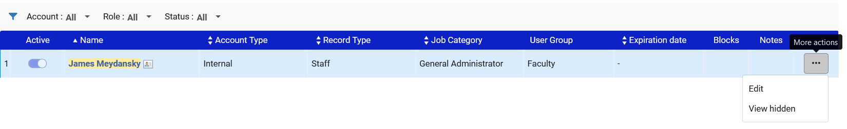
Example 1 - Restrict by User Group
Staff User Jacqueline Fernandez can edit user James Meydansky which has User Group “Faculty”

Slide 17
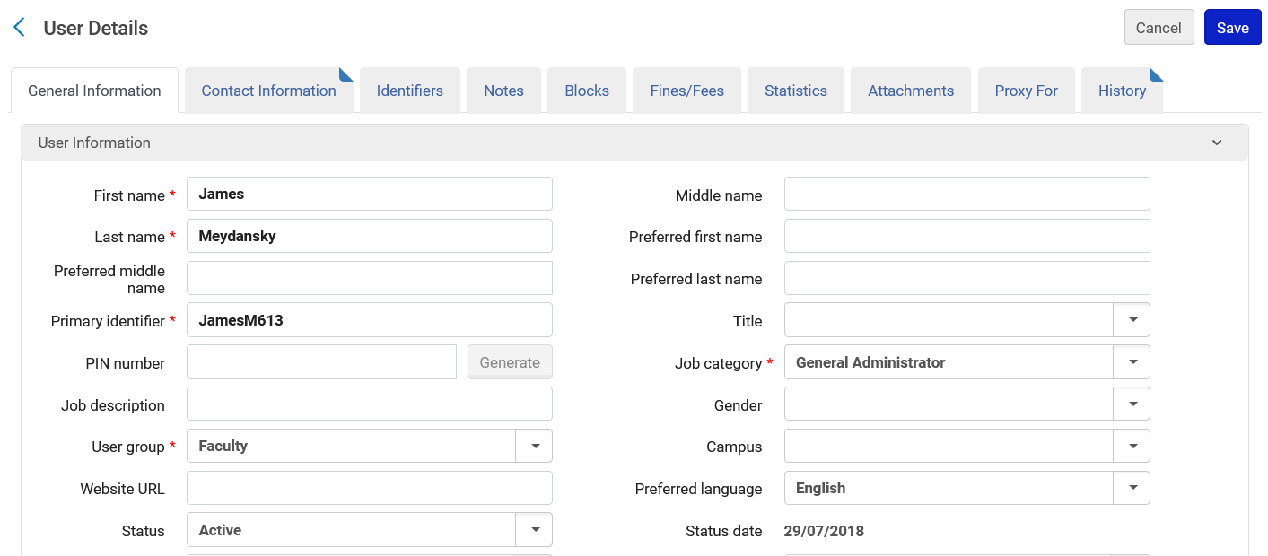
Example 1 - Restrict by User Group
After clicking “edit” we see the user details and edits can be made and therefore the fields are not greyed out

Slide 18
Example 1 - Restrict by User Group
Now we will change the following roles for Staff User Jacqueline Fernandez and in both cases “Can’t edit restricted users” will be checked.
  “Circulation Desk Manager”
  “Circulation Desk Operator”

Slide 19

Example 1 - Restrict by User Group
Role “Circulation Desk Manager” and “Can’t edit restricted users” is checked.
Checked

Slide 20
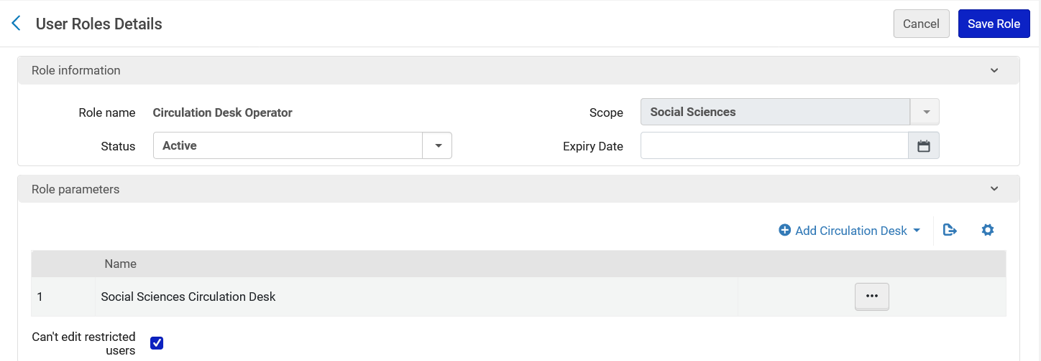
Example 1 - Restrict by User Group
Role “Circulation Desk Operator” and “Can’t edit restricted users” is checked.
Checked

Slide 21
Example 1 - Restrict by User Group
Now Staff User Jacqueline Fernandez cannot edit user James Meydansky which has User Group “Faculty” .
There is no “Edit” option. To see the user details the Staff User can click the name of the user and it will open in “View Only” mode.
No option to edit. We can click the user’s name to view

Slide 22
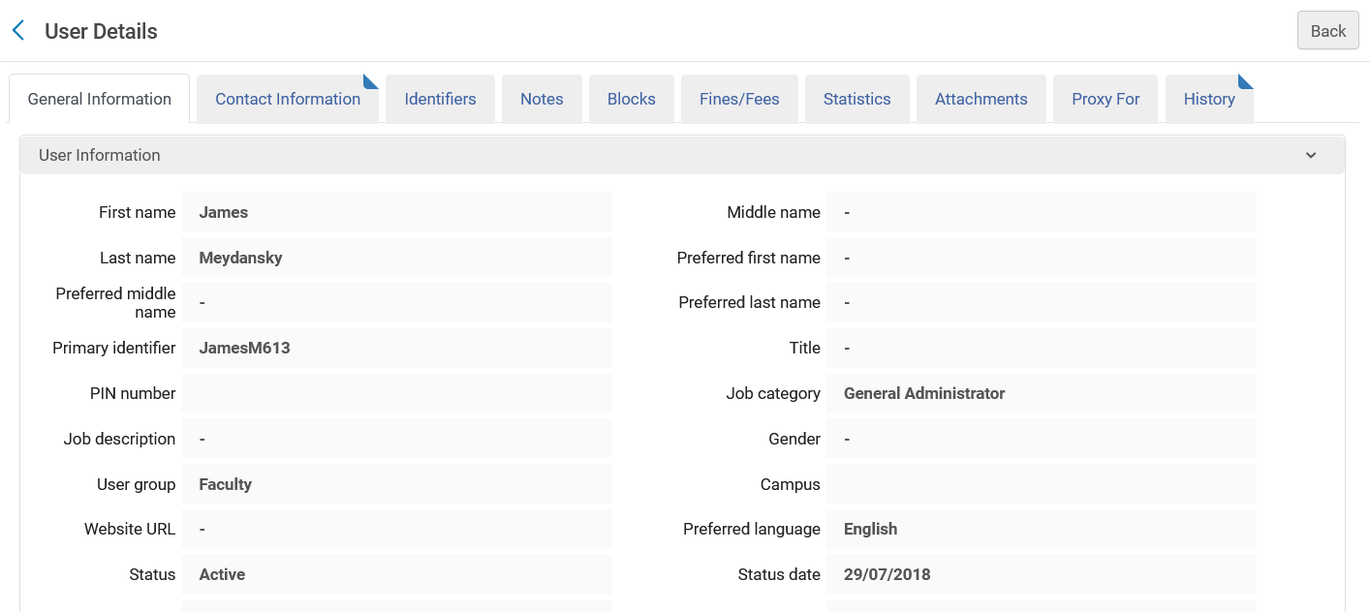
Example 1 - Restrict by User Group
After clicking the user’s name, we see the user details and it is “View Only” and therefore all of the fields are greyed out

Slide 23
Example 2 - Restrict by User Role

Slide 24
Example 2 - Restrict by User Role
In this example we will make the User Role “General System Administrator” be a “Restricted User Role”.
This means that any staff user who
  Has a role which can edit users
  The role(s) which can edit users does not have the checkbox “Can’t edit restricted users” checked
Will be able to edit all users including those with User Role “General System Administrator”.
If, however, the role(s) which can edit users does have the checkbox “Can’t edit restricted users” checked then the staff user will be able to edit all users except for those with User Role “General System Administrator”.
We will now see this live.

Slide 25
Example 2 - Restrict by User Role
We will access the configuration at ”Configuration > User Management > Roles and Registration > Users Restricted for Editing”.

Slide 26
Example 2 - Restrict by User Role
In the section “User Roles Restricted for Editing” we will click “Add Role”

Slide 27
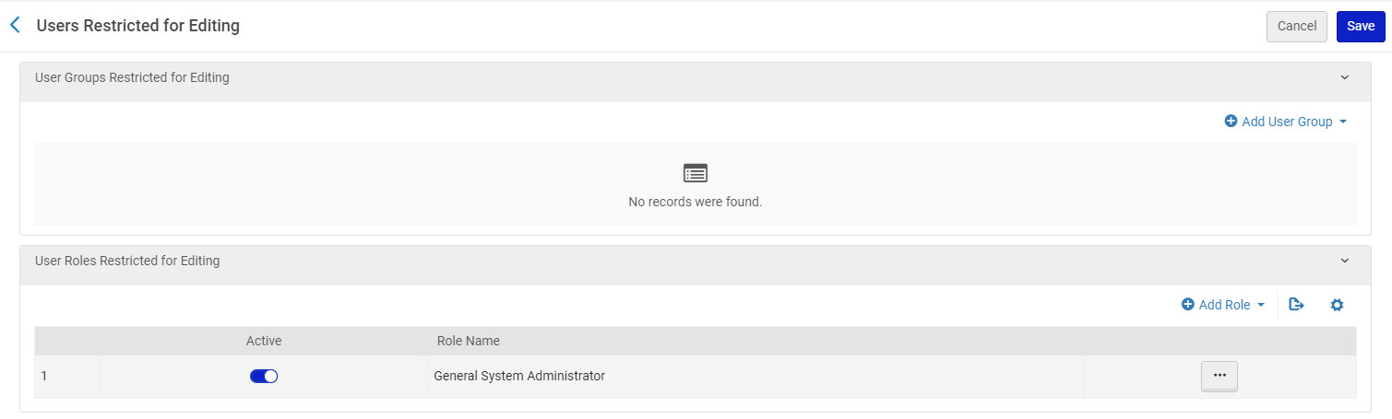
Example 2 - Restrict by User Role
We have added User Role “General System Administrator”

Slide 28
Example 2 - Restrict by User Role
User Marsha Brady has role “General System Administrator”

Slide 29
Example 2 - Restrict by User Role
Staff User Jacqueline Fernandez has roles
  “Circulation Desk Manager”
  “Circulation Desk Operator”
In both cases “Can’t edit restricted users” is not checked.
Jacqueline Fernandez can therefore edit all users.

Slide 30
Example 2 - Restrict by User Role
Role “Circulation Desk Manager” and “Can’t edit restricted users” is not checked.
Not checked

Slide 31
Example 2 - Restrict by User Role
Role “Circulation Desk Operator” and “Can’t edit restricted users” is not checked.
Not checked

Slide 32
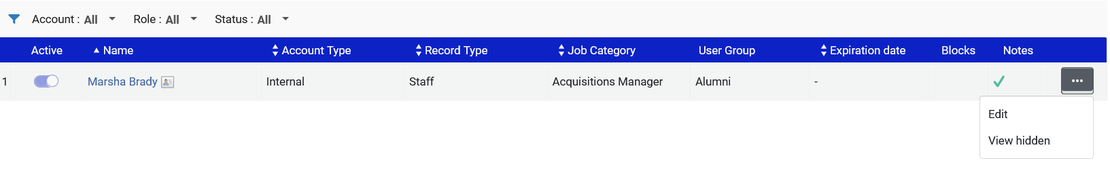
Example 2 - Restrict by User Role
Staff User Jacqueline Fernandez can edit user Marsha Brady who has role “General System Administrator”

Slide 33
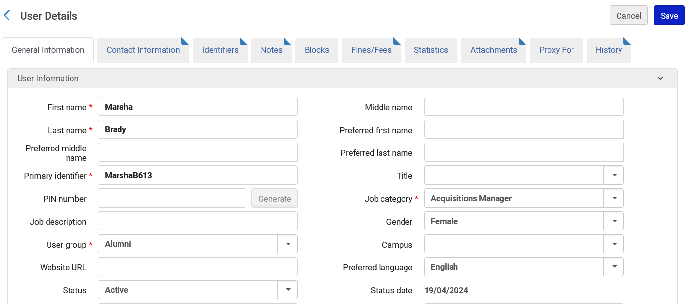
Example 2 - Restrict by User Role
After clicking “edit” we see the user details and edits can be made and therefore the fields are not greyed out

Slide 34
Example 2 - Restrict by User Role
Now we will change the following roles for Staff User Jacqueline Fernandez and in both cases “Can’t edit restricted users” will be checked.
  “Circulation Desk Manager”
  “Circulation Desk Operator”

Slide 35
Example 2 - Restrict by User Role
Role “Circulation Desk Manager” and “Can’t edit restricted users” is checked.
Checked

Slide 36
Example 2 - Restrict by User Role
Role “Circulation Desk Operator” and “Can’t edit restricted users” is checked.
Checked

Slide 37
Example 2 - Restrict by User Role
Now Staff User Jacqueline Fernandez cannot edit user James Meydansky which has User Group “Faculty” .
There is no “Edit” option. To see the user details the Staff User can click the name of the user and it will open in “View Only” mode.
No option to edit. We can click the user’s name to view

Slide 38
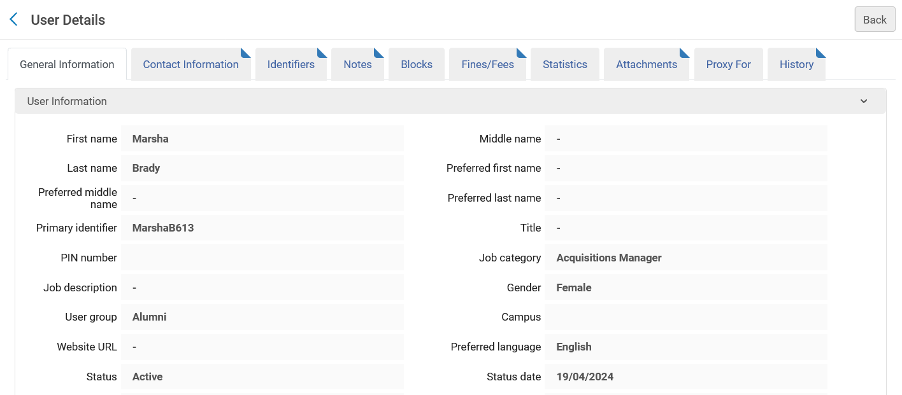
Example 2 - Restrict by User Role
After clicking the user’s name, we see the user details and it is “View Only” and therefore all of the fields are greyed out

